Slide 1
rockbuster presentation

Slide 2
How to stay competitive?
Concurrence is harsh and Rockbuster needs to keep up to keep, and even expand its customer base and revenues.
This is an analysis of the current situation at Ruckbuster, followed by some recommandations.

Slide 3
agenda
Our movies
Our customers
Geographical analysis
What makes a movie successful
Other facts
Final tips & takeaways

Slide 4
About Rockbuster films
 | Mean | Minimum | Maximum
Rental duration | 4.985 | 3 | 7
Rental rate | 2.98 | 0.99 | 4.99
Length | 115.272 | 46 | 185
Replacement cost | 19.984 | 9.99 | 29.99
Most common…
Release year | 2006 (only value)
Language | English
Special feature | {Trailers,Commentaries,”Behind the Scenes”}

Slide 5
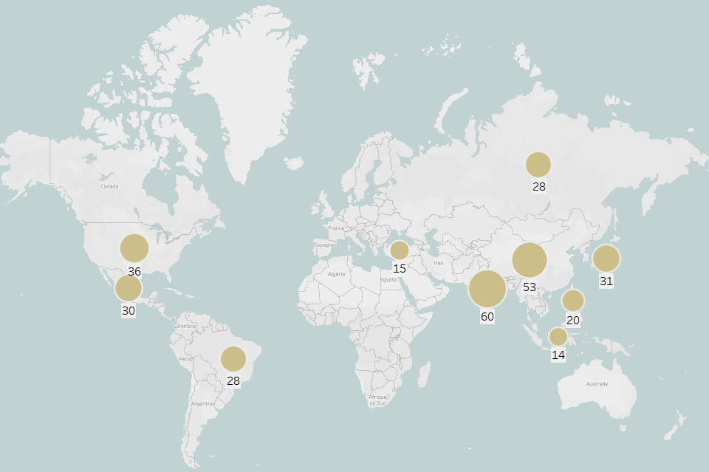
Where are our customers located?
Important to know if we considerer expanding.
Top 3:
China
India
USA
Top 10 countries in terms of customers

Slide 6
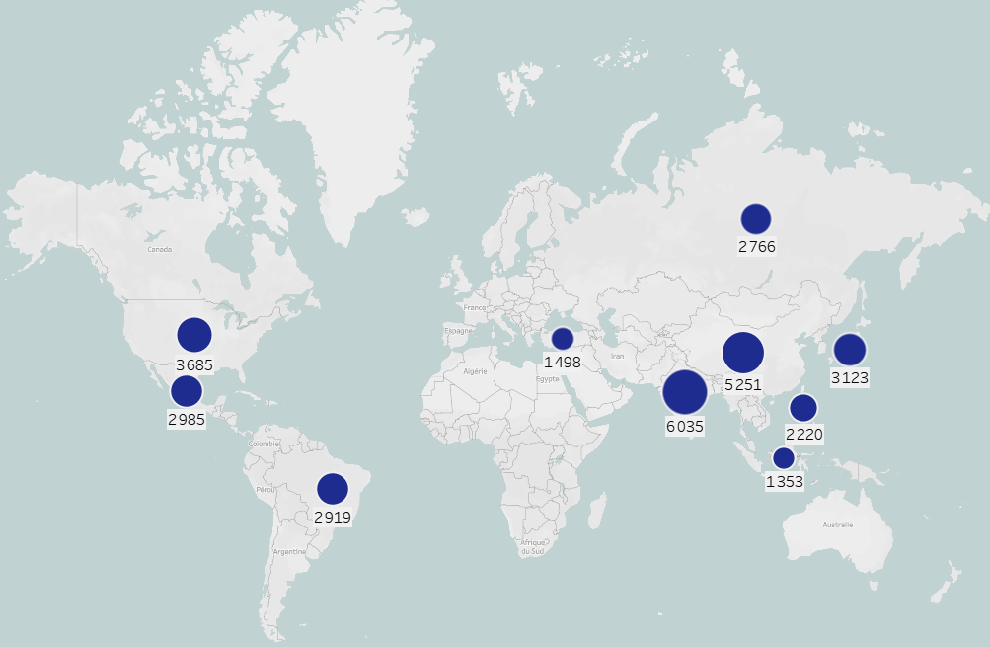
Where does our income come from?
Same dots and same size – our incomes come from the countries with the most customers.
Top 10 countries in terms of revenue

Slide 7

Top 10 cities in the word in term of customers
City | Country | Number of customers
Aurora | United States | 2
London | United Kingdom | 2
Kitwe | Zambia | 1
Adoni | India | 1
Dhule (Dhulia) | India | 1
Xintai | China | 1
Sivas | Turkey | 1
Mahajanga | Madagascar | 1
Nezahualcyotl | Mexico | 1
Escobar | Argentina | 1

Slide 8
Our most loyal customers in the top 10 cities
Customer ID | First name | Last name | Country | City | Total amount paid
84 | Sara | Perry | Mexico | Atlixco | 128.70
518 | Gabriel | Harder | Turkey | Sivas | 108.75
587 | Sergio | Stanfield | Mexico | Celaya | 102.76
537 | Clinton | Buford | United States | Aurora | 98.76
367 | Adam | Gooch | India | Adoni | 97.80

Slide 9

Successful Genres
Sports
Sci-Fi
Animation
NOT thriller?
Note: we have 11 thrillers VS 1000+ animation and sports

Slide 10
Successful Ratings
Most popular is PG13

Slide 11
Other facts
We have only two stores, one in Canada and one in Australia
They don’t match the location of our customer base
To be able to keep up with the competition, we need to expand
Films offer: we offer 1000 movies and Netflix 3500+ We only offer movies from 2006. We need to offer other movies popular in 2024.
Start to offer online streaming for convenience?

Slide 12
Final tips & takeaways
Top 3 countries in customer base: India, China, USA
Our most loyal customers have been identified – loyalty team can proceed to reward them to boost popularity
Expanding our movies selection beyond 2006
Invest in Sports, Science Fiction, Animation
Expanding staff – in countries where customers are
Become a streaming platform?

Slide 13
Thank you
Mathilde Lehalle
mathilde_lehalle@msn.com

